Slide 1


Slide 2
Content
Sentiment Analysis
Data Set
Word Cloud Model
Encoding
Neural Network Model
Keras
Steps Preparing Text
Sequential Model
Future Model (Transformer Model)

Slide 3
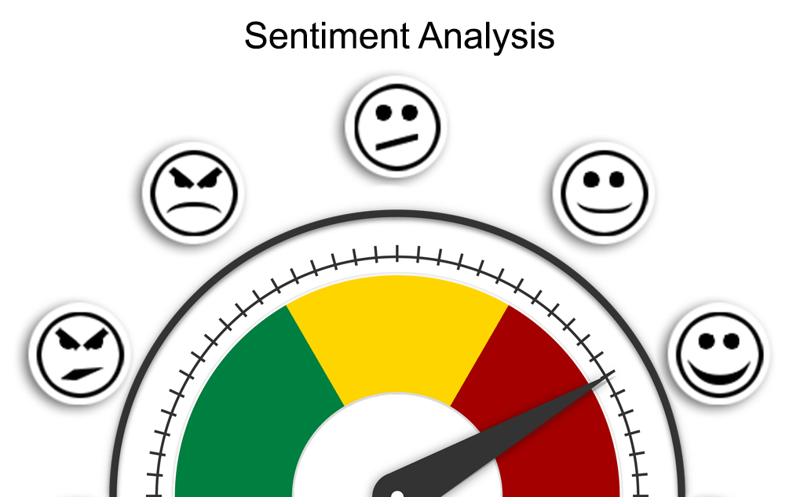
Sentiment analysis (also knows as opinion mining, or emotion AI) is a method of analyzing text data to identify its intent.
The goal is a automatically recognize and categorize opinions expressed in the text to determine overall sentiment.
Sentiment analysis is the process of analyzing online pieces of writing to determine the emotional tone they carry, whether they’re positive, negative, or neutral. In simple words, sentiment analysis helps to find the author’s attitude towards a topic.

Slide 4
Content
Sentiment Analysis
Data Set
Word Cloud Model
Encoding
Neural Network Model
Keras
Steps Preparing Text
Sequential Model
Future Model (Transformer Model)

Slide 5
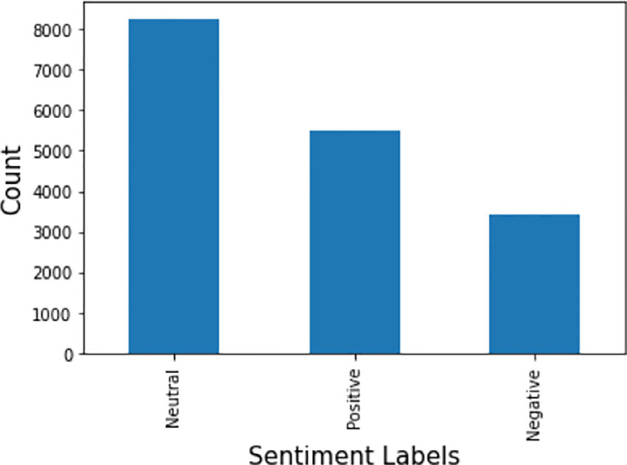
A data set is structure collection of data points related to a particular subject. A collection of related data sets is called a database.
Data sets can be tabular or non-tabular. Tabular data sets contain structured data that is organized by rows and columns. Non-tabular data sets contain unstructured data contained by brackets.
UNLABELED DATA
*Unlabeled data is used in unsupervised learning.
*Unlabeled data is easier to acquire and store.
*Unlabeled data is more limited in its usefulness.
LABELED DATA
*Labeled data is used in supervised learning.
*Labeled data us more difficult to acquire and store.
*Labeled data can be used to determine actionable insights

Slide 6
Content
Sentiment Analysis
Data Set
Word Cloud Model
Encoding
Neural Network Model
Keras
Steps Preparing Text
Sequential Model
Future Model (Transformer Model)

Slide 7

Word Cloud Model
A word cloud is a visual representation of information or data. It shows the popularity of words or phrases by making the most frequently used words appear larger or bolder compared with the other words around them. A word cloud contains a set of data such as a list of words, text from a blog post, or a collection of written items like a series of articles.
The word cloud graphic is a visual representation that supplements a section of text to help readers better understand an idea or approach a subject from a different angle.

Slide 8
Content
Sentiment Analysis
Data Set
Word Cloud Model
Encoding
Neural Network Model
Keras
Steps Preparing Text
Sequential Model
Future Model (Transformer Model)

Slide 9
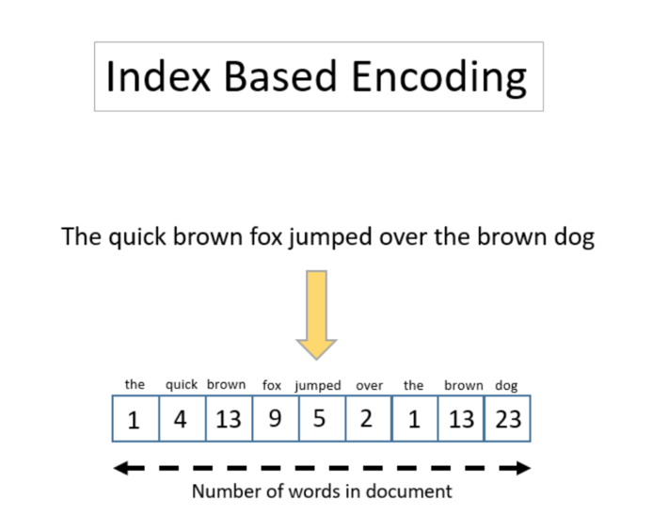
Encoding
An encoding standard is a numbering scheme that assigns each text character in a character set to a numeric value. A character set can include alphabetical characters, numbers, and other symbols.
Different languages commonly consist of different sets of characters, so many different encoding standards exist to represent the character sets that are used in different languages.

Slide 10
Content
Sentiment Analysis
Data Set
Word Cloud Model
Encoding
Neural Network Model
Keras
Steps Preparing Text
Sequential Model
Future Model (Transformer Model)

Slide 11
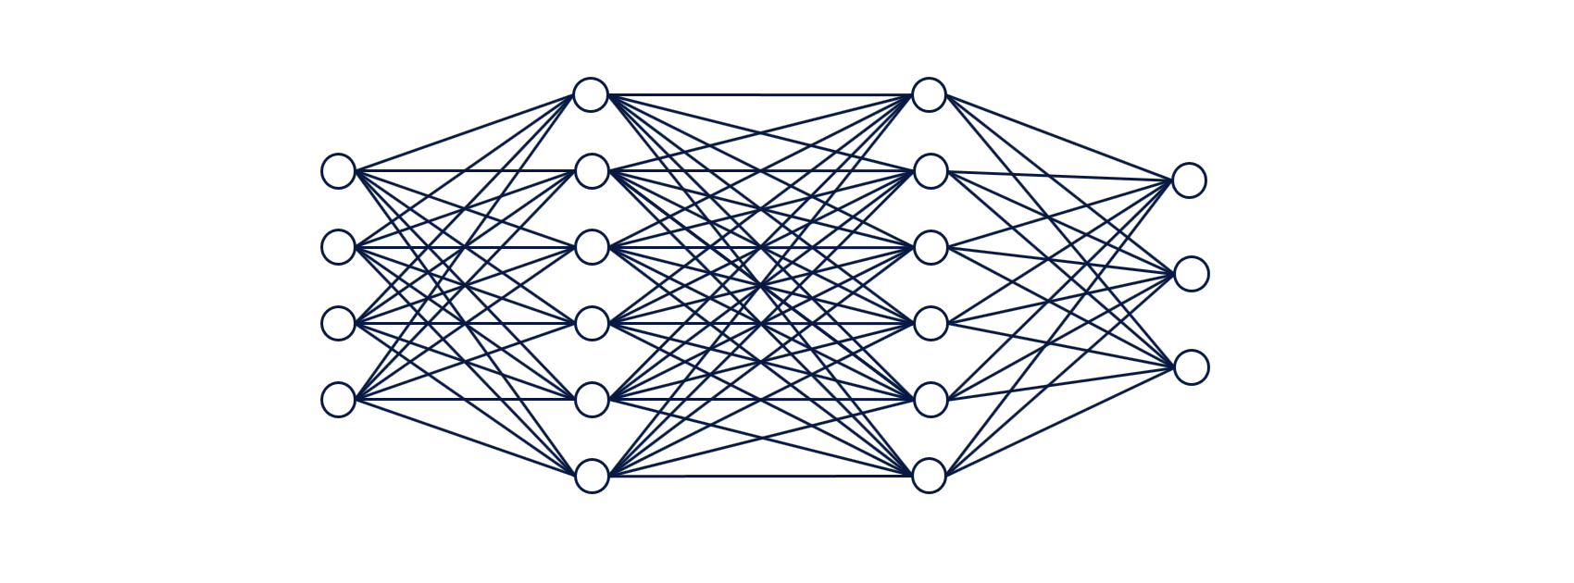
Neural Network Model
Now we have our data, and it’s rather helpfully been preprocessed, we can move on to the creation of the neural network. The specific neural network we’re using to analyse review sentiment is a recurrent neural network called LSTM or Long Short-Term Memory. This model is really useful and can be used for a variety of things, including time series analysis, anomaly detection and speech and handwriting recognition.
First, we’ll load the Sequential model class and set up something called the embedding layer. This basically converts the Numpy arrays into “dense vectors” of a fixed size using padding, so it’s more convenient for the neural network to handle. The embedding layer has a vocabulary size of 20000 words (because that’s the num_words argument we passed when we loaded up the data), and while the 128 value denotes a 128 unit output dimension.

Slide 12
Content
Sentiment Analysis
Data Set
Word Cloud Model
Encoding
Neural Network Model
Keras
Steps Preparing Text
Sequential Model
Future Model (Transformer Model)

Slide 13

Keras
Keras is a high-level, deep learning API developed by Google for implementing neural networks. It is written in Python and is used to make the implementation of neural networks easy. It also supports multiple backend neural network computation.
Keras is relatively easy to learn and work with because it provides a python frontend with a high level of abstraction while having the option of multiple back-ends for computation purposes. This makes Keras slower than other deep learning frameworks, but extremely beginner-friendly

Slide 14
Content
Sentiment Analysis
Data Set
Word Cloud Model
Encoding
Neural Network Model
Keras
Steps Preparing Text
Sequential Model
Future Model (Transformer Model)

Slide 15
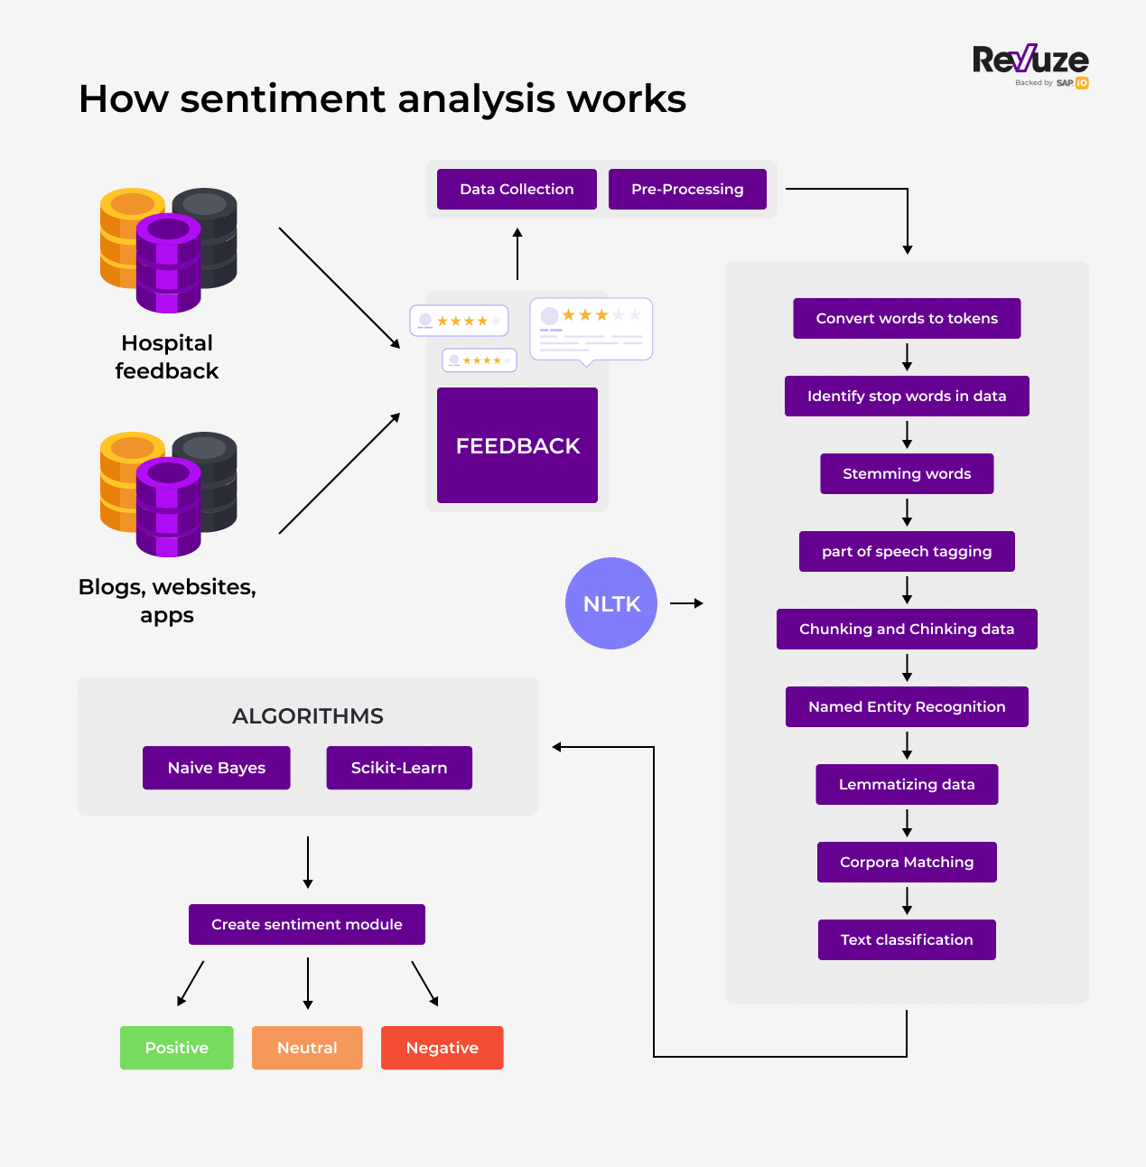
Some Steps For Preparing Sentiment Analysis of Text
Preparing Your Jupyter Notebook Environment.
Analyzing the Dataset.
Preparing Data for Training.
Building and Training the Neural Network.
Evaluating the Model

Slide 16
Content
Sentiment Analysis
Data Set
Word Cloud Model
Encoding
Neural Network Model
Keras
Steps Preparing Text
Sequential Model
Future Model (Transformer Model)

Slide 17
Sequential Model
A sequential model is appropriate for a plain stack of layers where each layer has exactly one input tensor and one output tensor.
Embedding
Conv1D
MaxPooling1D
Bidirectional
Dropout
Dense

Slide 18
Content
Sentiment Analysis
Data Set
Word Cloud Model
Encoding
Neural Network Model
Keras
Steps Preparing Text
Sequential Model
Future Model (Transformer Model)

Slide 19
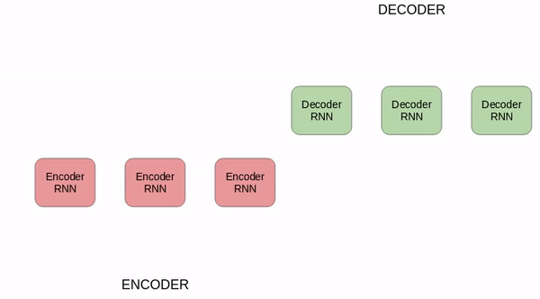
Future Approach
Transformer Model NLP

Slide 20
Thank You

